Slide 1

Predicting customer buying behaviour
14/09/2024

Slide 2
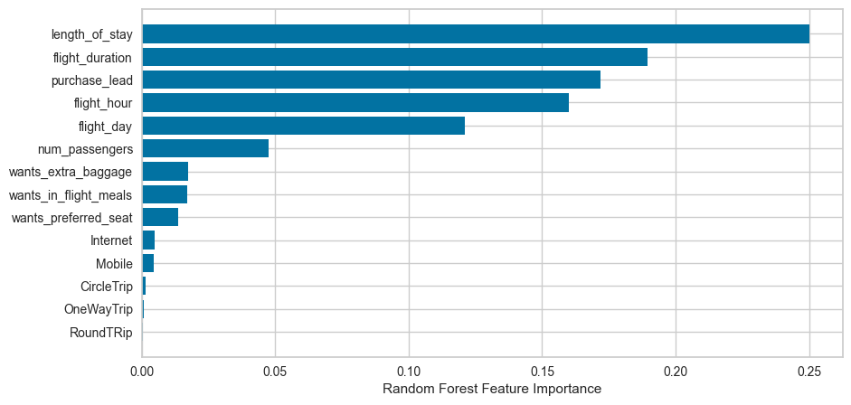
predictive model result
Random Forest Model
AVERAGE ACCURACY: 90.3376%
(cross-validation 10-fold)
Top 5 features
route
booking_origin
flight_duration
wants_extra_baggage
length_of_stay

